Slide 1
CSE7302 - INTERNSHIP Review-1 Presentation FULL STACK DEVELOPMENT
Student Details
Name | Mounika A
Roll No | 20221CSE0329
Section | 8CSE11
Under the Supervision of,
Dr. Sudha P
Associate Professor
Presidency School of CSE
Presidency University
Name of the Program: Computer Science and Engineering
Name of the HoD: Dr. Asif Mohammed
Name of the Program Internship Coordinator: Mr. Sakthi S
Name of the School Internship Coordinator: Dr. Md Ziaur Rahman

Slide 2
Content
About Company or Organization
Working domain or the technology
About your team and reporting Manager
Challenges Faced in Internship
Objectives of the work
Internship Roadmap
Github Link

Slide 3
About Company or Organization
Company Overview – Prola Tech
Prola Tech is a technology-driven software development and IT services company.
It provides end-to-end services from planning, developing, implementing, and managing.
It helps businesses perform in an efficient, faster, and profitable manner.
Headquartered in Bangalore , India, serving clients across multiple industry domains.
Vision: to deliver innovative, reliable, and scalable digital solutions.

Slide 4
Services and Products
Mobile Application Development :- Development of user-friendly and scalable mobile applications.
Web Application Development :- Design and implementation of secure, responsive web applications.
Internet of Things (IoT) :- Integration of smart devices and data-driven IoT solutions.
Web Services :- Development of APIs and backend services for application integration.
Cloud-based Services :- Deployment and management of applications on cloud platforms.

Slide 5
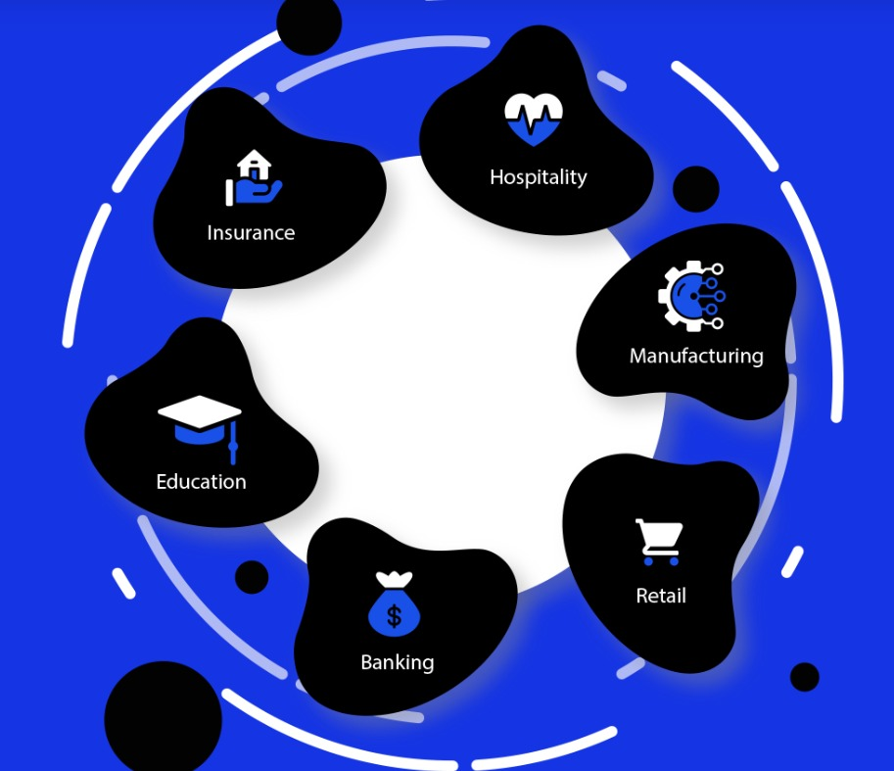
Clients and Industries
Banking
Insurance
Education
Hospitality
Manufacturing
Retail
Key Projects
Tally Integrated CRM
ERP Shipping Management System
Village Asset Tracking System

Slide 6
Working domain or the technology
Domain :- Full Stack Development
Features :-
Works on both Frontend and Backend technologies.
Handles Database Integration.
Enables creation of dynamic and interactive web applications.
Supports APIs and CRUD Operations for data handling.
Importance :-
Develops complete web applications.
Highly in-demand skill in IT industry.
Provides career growth opportunities.

Slide 7
About your team and reporting Manager
Working under the guidance of the Project Manager who provides over all direction and supervision.
The team consists of frontend , backend developers , testers and interns collaborating the project.
Team follows an Agile working approach for feature development, bug fixing, and system improvements.
Tasks planned, assigned, and reviewed systematically.
Regular communication was maintained through team meetings, discussions, and progress updates.

Slide 8
Challenges Faced in Internship
Finding the right internship opportunity aligned with my domain.
Preparing and the clearing the interview process.
Understanding project requirements, workflow, and coding standards in the initial phase.
Adjusting to team collaboration and professional work environment.
Managing time effectively while learning new technologies and completing assigned tasks.

Slide 9
Objectives of the work
To understand the project requirements and overall full stack application workflow.
To apply the web technologies in real-time development tasks.
To gain hands-on experience in frontend and backend development.
To learn and follow coding standards, version control, and best practices.
To assist in feature development, bug fixing, and system enhancement activities.
To improve technical skills, teamwork, and professional work practices.

Slide 10
Internship Road Map
Note: Write in the below table what u will be achieving in each review
Review 1
Onboarding & Fundamentals
Understanding the project requirements , development workflow and basic full stack concepts.
Review 2
Full Stack Skill Development
Development of frontend layouts, learning backend fundamentals , and practicing version control , coding standards.
Review 3
Application Development
Integration of frontend and backend components and resolution of functional and
Interface-related issues.
Review 4
Final Review
Advanced Development & Testing
Enhancement of application functionalities , optimization of code , database operations and testing
Project Completion and learning Outcomes
Completion of assigned modules , hands-on full stack development experience and improvement in teamwork and communication skills.

Slide 11
Github Link
https://github.com/mouni0304/Full-Stack-Development-Internship

Slide 12
Q&A

Slide 13
Thank you !!

